Slide 1
Overview of School-Based Behavioral Health
Dimple Desai, MSW
Atlanta School-Based Behavioral Health Forum
April 15, 2019
Notes:
Thank you Erica. I’m delighted to share with you all some exciting work that’s being implemented across the state of Georgia that’s helping to address service provision of mental health services for our students. As a social worker and a research associate the Center of Excellence I am passionate about maintaining the well-being children.

Slide 2

Who We Are: Georgia Health Policy Center
Conceptual Framework
Research
Health
Evaluation
Translation
Programs
Policy
Implementation
Notes:
The Center of Excellence for Children’s Behavioral Health (commonly referred to as the COE) is a signature program within the GA Health Policy Center. We are housed within the Andrew Young of School of Policy Studies at GSU
The GHPC and COE root our work with our partners in a conceptual framework where information garnered from research is translated to support policy and programs. For example, ongoing program evaluation contributes to the body of research and supports continuous quality improvement of behavioral health programs. Lessons learned from policy and program implementation also inform our research agenda.
One of the initiatives included on our research agenda is SBMH and we are a proud partner along with the Carter Center, VOICES, GA Appleseed, DBHDD, Emory University, DOE and many others in informing the work.
For the purpose of our discussion today, SBBH and SBMH are used interchangeably, really we are talking about diagnosis and treatment of mental health, substance abuse, and associated physical disorders provided in a school setting.

Slide 3
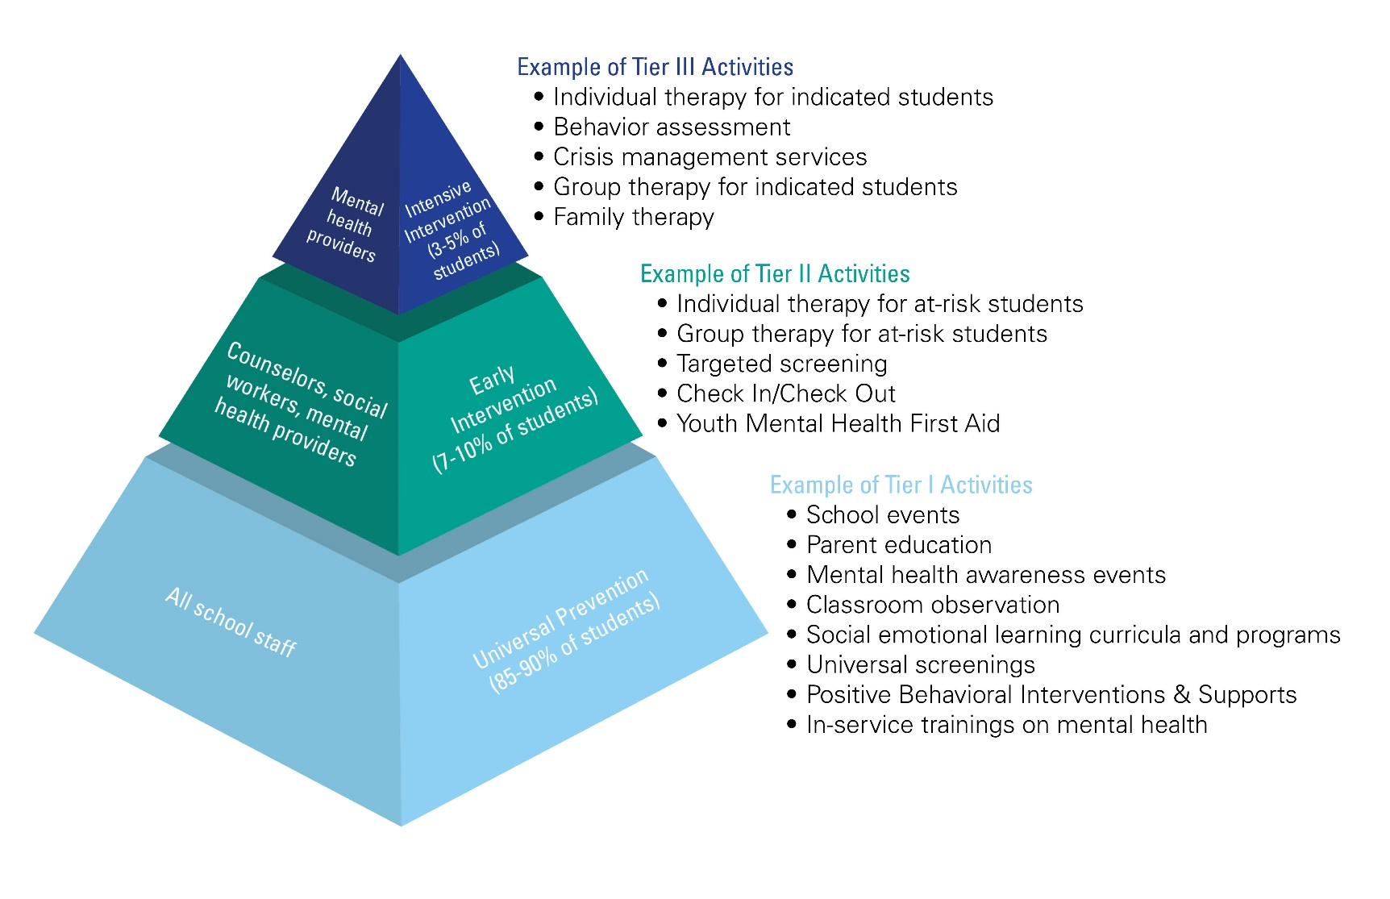
Framework for SBMH Services
Notes:
A child’s mental wellness is critical to ensuring success at home and at school. An estimated one in five children under the age of 18 has a diagnosable mental health disorder.^{1, 2} Unfortunately, those in greatest need often do not receive the needed support, as indicated by the 75%-80% of those who require services but do not receive them
By placing mental health professionals in schools, SBMH programs increase access to needed mental health services; promote earlier identification of and intervention for mental health needs; and foster partnerships between community based providers and schools/school districts.
One conceptual model used to guide SBMH is the three-tiered intervention framework, where provision of mental health services fall into three distinct levels (Figure 2). (6, 8, 11, 21)
• Tier I programs and activities are generalizable to an entire school and are implemented school-wide.
• Tier II programs and services target students at risk of developing mental health concerns and are more specialized.
• Tier III services are tailored to a small population of high-risk students and are more intensive interventions

Slide 4


Select Models of SBMH in Georgia
Apex
Project 180
Georgia Network for Educational and Therapeutic Support Pilot
System of Care State Plan
Notes:
There are a variety of SBMH initiatives taking place in GA. The COE is currently working with 4 key initiatives that are using different frameworks for linking and delivering behavioral health services to students in GA. These include:
DBHDD’s Apex Program
CHRIS 180’s Project 180,
local GNETS project
Georgia Apex Program Spring 2015 as a DBHDD pilot initiative to increase access to BH services for those students with most severe conditions (tier 3). The 3 initial goals of the GAP as outlined in this slide include:
Goal1: to increase access to community-based SBMH services.
Goal 2: To support early screening and detection of mental health issues, and
Goal 3: To increase sustained collaboration among community based behavioral health providers and local schools and school districts.
DBHDD funds 29 providers, comprised of providers within DBHDD’s tier 1 safety net providers as well as a few Tier 2 providers
As a technical assistance and evaluation partner with the COE collects monthly and annual aggregate data from providers.
Apex programming is currently in 87 counties (55%), 101 school districts (56%), and 396 schools (17%) in the state of Georgia
Support implementation but there is No prescribed EBP; focus on local solutions to local concerns
The COE is also working with CHRIS 180 on a trauma – informed SBMH framework – PROJECT 180. CHRIS 180 received a SAMHSA grant to implement the ARC: Attachment, Regulation, & Competency framework to support the implementation of a trauma-informed SBMH initiative
ARC is designed as both an individual level clinical intervention, to be used in treatment settings for youth and families, and as an organizational framework, to be used in service systems to support trauma-informed care.
begins with training both behavioral health and school professionals in the model to collaboratively address the needs of students across all tiers of the SBMH
The framework addresses key factors associated with resilience
SOC state plan that has specific tasks identified to assess and grow access and utilization of SBMH services throughout GA.
The South Metro GNETS incorporates an evidenced based 3-tiered approach to the delivery SBMH services
Fours schools that take part in the pilot
incorporated universal social, emotional and behavioral screenings as well as trauma informed care and practices
Tier 2 & 3 individual and group therapy;
Tier 3 receives HFW by the school social worker through a warm hand-off to the wrap care coordinator or the certified parent peer support specialist/mentor
SOC state plan that has specific tasks identified to assess and grow access and utilization of SBMH services throughout GA. The Interagency Directors Team (IDT) is the state’s multi-agency SOC leadership collaborative, whose mission it is to manage, design, facilitate and implement the Child and Adolescent Mental Health SOC in Georgia. In 2017, the IDT drafted a SOC State Plan identifying five focus areas of the plan: one of which is Access; SBMH is a strategy to help increase access to services
Goal 1: Establish Baseline Access to 3-Tiers of SBMH - IDT survey of GA public schools inventorying the array of SBMH services currently available across the 3-tiers
2. Goal 2: Increase No. of Schools with Access to All 3-Tiers of SBMH - Expand Apex program to 13 additional awards in 2018-2019 school year
IDT collaboratively develops strategies to increase the number of schools with access to 3-tiers of SBMH services
3. Goal 3: Increase No. of Students Receiving SBMH Services - Primary data collection and secondary data analysis to assess the number of students receiving SBMH services

Slide 5
Implementation of SBMH Services
Providers
School Partnerships
Referrals
Services
  Examples of providers:
    Employed by a community mental health provider organization or directly by the school or school district
  Provide services to one or multiple schools
  Leadership buy-in
  Memorandum of understanding including data sharing agreement
  Presence of Tier 1 activities
  Counselors, school social worker, teacher
  Self-referral
  Parents
  State entities
  Broad spectrum of services
  Services can be grounded in evidence based practice
  At little to no cost
Notes:
Schools are strategic locations for service provision, given that they eliminate the challenge of transportation and provide access to students with unmet mental health needs. Providers partner with schools to identify the appropriate referral process and identification of students in need of services. Providers engage in service delivery and rely on a variety of evidence-based practices to inform their work
Providers:
SBMH professionals can provide services at one or multiple schools. Depending on the program, SBMH providers are either employed by mental health providers that are contracted to provide services within schools or employed directly by schools, school systems, or school district.
Referrals:
Students may be referred to SBMH services by an adult, such as a school social worker, teacher, or counselor, or by the student him/herself
Services:
Programs offer students and their families a broad spectrum of mental health services at little to no cost such as
Screening and evaluation
Psychometric testing
Medication management
Counseling (individual, small group, or family)
Tier 1 Partnering with schools that have implemented Tier I interventions promoting universal prevention, such as Positive Behavioral Intervention and Supports (PBIS) and Youth Mental Health First Aid (YMHFA) programs before initiating SBMH services, demonstrate a school’s priority in ensuring mental wellbeing for both students and staff, resulting in an environment conducive to the layering of more targeted intervention strategies.

Slide 6
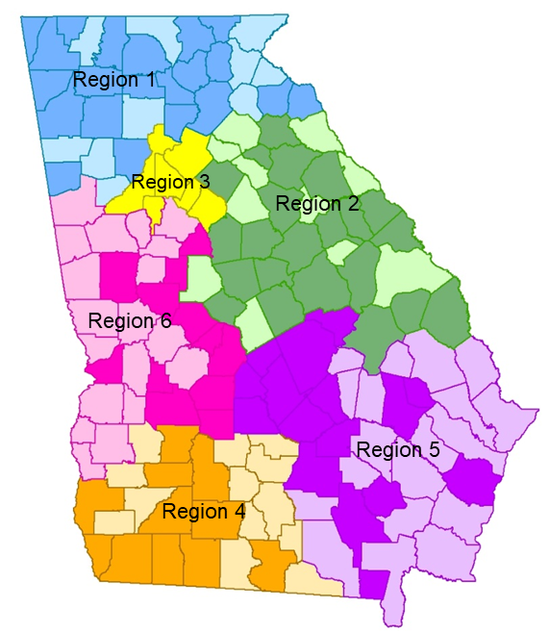
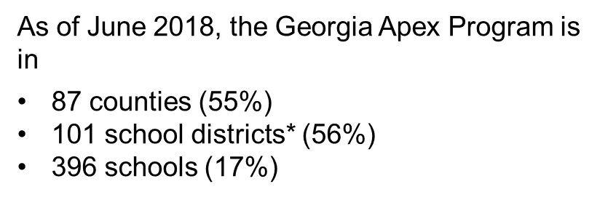
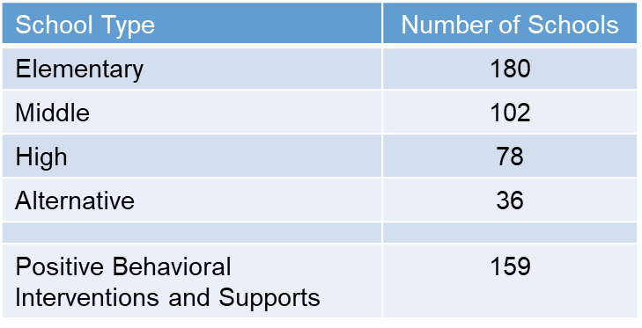
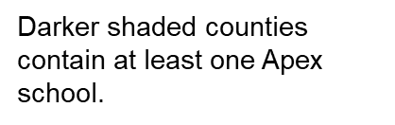
Georgia Apex Program Reach, Year 3
*Includes two alternative, military, and state charter schools
Notes:
435 schools
8,705 students receiving first time services
123,002 services provided in schools
Note: All Region 3 counties have at least one Apex school.
Apex has been somewhat more highly concentrated in elementary schools, supporting the goal of early detection of mental health issues and prevention and early intervention as important in effectively promoting children’s mental health.
Apex is currently in 159 schools with co-existing PBIS programs, at various stages of implementation.

Slide 7
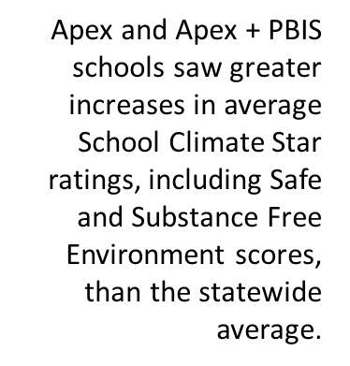


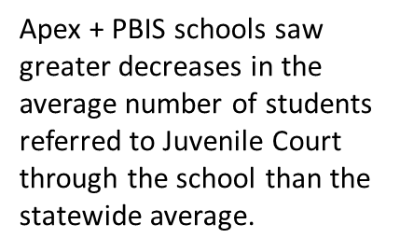

School-related Program Outcomes
Notes:
Safe and Substance Free Environment Scores take into account many factors, including the number of violent, drug related and bullying incidents in a school
In Apex Schools (n=117): There are 117 schools that were reported on 3 or more times in Year 1 and Year 2, indicating an engaged Apex program and a sustained partnership between the school and the provider. We chose to examine the school climate in these schools over time (from before Apex implementation in the 2014-2015 school year and after two years of Apex program implementation in the 2016-2017 school year).
School Climate Star ratings increased
Safe and Substance Free Environment Scores increased
Average out of school suspensions (OSS) decreased by 2x the statewide average (19.24 for Apex schools vs 9.45 statewide)
Average number of any discipline incident decreased by 46.51 per school (vs 25.15 statewide)
Average number of any discipline action decreased by 42.79 per school (vs 27.15 statewide)
Average number of juvenile court referrals reduced
Apex & PBIS Schools (n=47): Of the 117 Apex schools, 47 were also PBIS schools.
School Climate Star ratings increased by 2x the statewide average
Safe and Substance Free Environment Scores increased by 2x the statewide average
Average number of juvenile court referrals reduced by 2x the statewide average

Slide 8
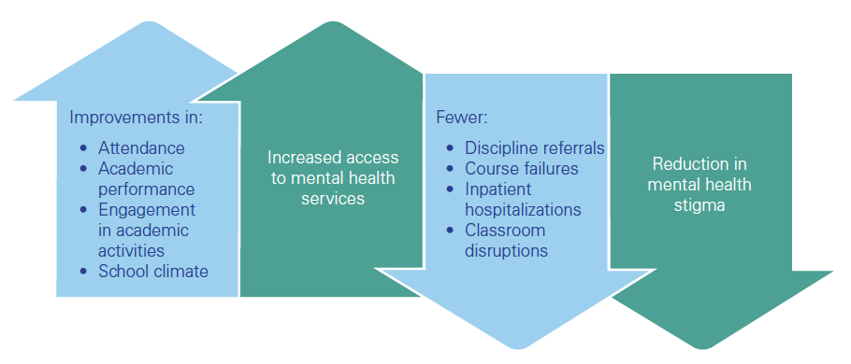
Potential Benefits of SBMH
Notes:
School-based mental health (SBMH) programs provide a continuum of mental health services to students and their families in the school setting and a growing body of literature supports benefits of implementing SBMH services. As validated by Apex evaluation data we are seeing improvements in…
Reduction in MH stigma:
Over time we have seen an increase in referrals for service being made by parents and self or peer referrals which also indicates decreased stigma and increased acceptability around mental health
In addition to the potential benefits we may wish to consider evaluating the potential costs of not implementing SBMH…..Examples of what we may want to consider:
Teacher and staff turnover: Schools incur costs when they have to post and hire positions whether teaching, administrative, facilities or maintenance.
Facility expenses: Anytime buildings, materials, technology or furniture depreciate at a faster pace than normal, items must be replaced, facilities and buildings must be repaired. School systems regularly need to repair and replace but when this is required sooner than planned it emerges as additional and unplanned expenses.
Suspensions: When students are remanded to in-school suspensions, additional staff and space are required to supervise students during these hours and days. Associated expenses must be covered.
Local real estate values: School culture and performance measures are regularly considered by real estate agents and home buyers when not only deciding which home to buy but how much to pay. Purchase prices impact home valuations and the resulting property taxes. As an important source of local revenue, whenever poor school performance decreases home values, the revenue a local government and the school system do not collect can be understood as costs to the system as well.
As I’ve shared with you there is currently a range of SBMH programming that’s being implemented across the state. One is not more right than the other, local context and priorities really drive the decision to determine what's the right fit for each community. Most important is we’ve identified another strategy to provide access to MH services for our children in Georgia.

Slide 9


Contact us:
Center of Excellence for Children’s
Behavioral Health
Georgia Health Policy Center
Georgia State University
404.413.0075 (phone)
gacoe@gsu.edu
gacoeonline.gsu.edu
Notes:
Thank you

