Slide 1
School-Justice Partnership Model: Increasing School Climate by Reducing Court Involvement
Steven C Teske, Chief Judge
Juvenile Court, Clayton County, GA

Slide 2
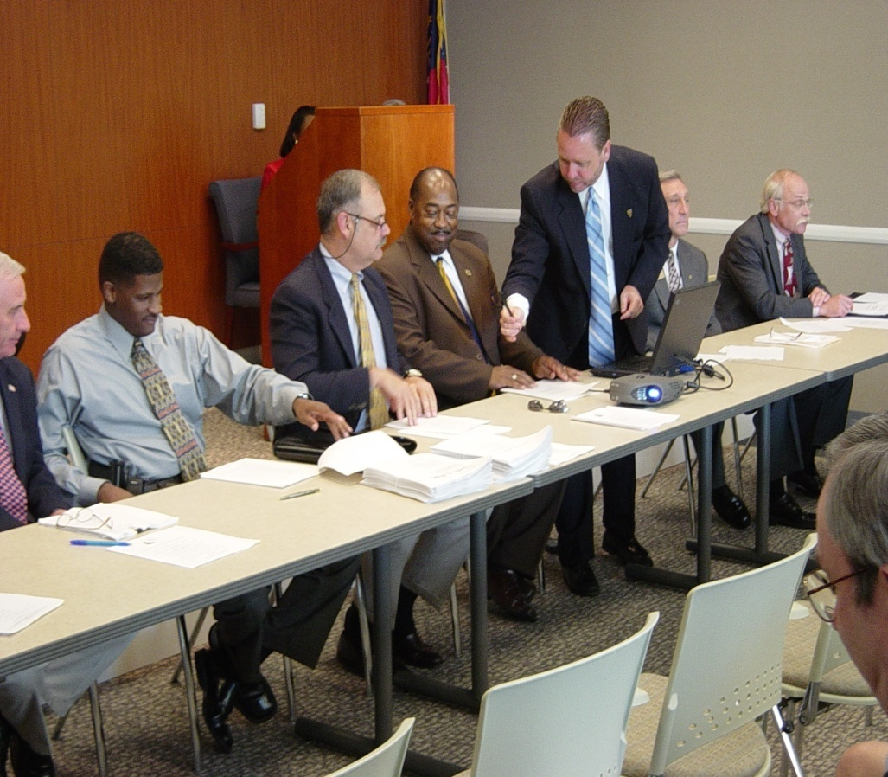
What is the School-Justice Partnership Model?: In a Nutshell
Developed in 2003 in Clayton County, GA;
MOU between schools, law enforcement, and courts;
To create a School-Justice Partnership;
Using a Focus Act Decision Tree;
By replacing arrests with a Graduated Response Program;
That is guided by a Role Conflict Avoidance Model;
Using the Positive Student Engagement Model for School Policing; and
Create an independent backbone agency to deliver services to chronically disruptive students

Slide 3
FOCUS ACT
What offenses have
occurred on your
campuses?
MEMORANDUM
OF
UNDERSTANDING
DECISION
TREE
Will the offense be
diverted from a formal
petition?
FOCUS ACT
YES
NO
YES
Once in court, is it more
probable than not the judge will divert or informally adjust the case?
Are there mitigating circumstances that can be separated from aggravating circumstances?
YES
NO
NO
REFERRAL
TO COURT

Slide 4





Role Conflict Avoidance Decision-Tree
Is the conduct delinquent or a school infraction?
Delinquent
School Resource Officer Involved?
YES
Is it a Focus Act?
Infraction
NO
No Law Enforcement Involvement
Can it be resolved using problem-oriented approach?
Response applied by School Resource Officer as set forth in Graduated Response Matrix
This decision-tree is designed to aid school-justice partnerships with developing written guidelines that clearly distinguish the role of school police and school administrators to avoid role conflict that results in the unintended criminalizing of school rules. This process also aids in developing least restrictive responses when the infraction is delinquent in nature. As suggested in this process, SRO’s should be given discretion at every decision point to resolve delinquent acts using a problem-solving model if possible.
School Code Responses applied by Administrator
Referral to Juvenile Court

Slide 5


Focus Act Response Matrix
ACTS
List Focus Acts:
Person
Property
Weapon
Inappropriate Touching
Drugs
Public Order
Other
TYPE
RESPONSES

Slide 6



Graduated Response Decision Tree
FIRST ACT
SECOND ACT
THIRD ACT
NO
Does the type of act require restitution, drug assessment, TX, or other response?
YES
Is a Graduated Response necessary?
Is a referral to court necessary?
NO
NO
YES
YES
WRITTEN WARNING
Match response to act using Response Matrix
COMPLAINT
Best practice requires that a response process engage the decision-maker at every decision point to ask what response can be narrowly tailored (least restrictive) to achieve the desired outcome (modify behavior)

Slide 7
COMPONENT | PURPOSE | GOALS/CONDITIONS
Data Collection
Who collects it?
How is it collected?
How is it used?
How is it reported?
Periodic quality control meetings
Who attends?
How often?
What are the Performance measures?
What are the outcome measures?
What is the process for modifications?
Quality Control
Who & How on implementation & oversight
INTER-AGENCY
AGREEMENT/MOU

Slide 8
Total School Arrests Pre & Post School-Justice Collaborative Agreement
SRO’s removed from middle schools due to budget cuts
SRO Program Begins

Slide 10
School-Justice Partnership Begins

Slide 11
Juvenile Delinquent Arrests Decline 82%
School-Justice Partnership Begins

Slide 12
Clayton County Snapshot: Felonies Decline 64%
School Justice Partnership Begins

