Slide 1

Behavioral Health
School-Based Health Centers
Veda Johnson, MD
Professor
Department of Pediatrics
Emory University School of Medicine
April 15, 2019

Slide 2
Lessons Learned
‘The Head is Part of the Body’
  Requires a multidisciplinary approach
A Child’s behavior is a reflection of the stability of their environment
Aberrant behavior begins early
  Earlier you identify and address, the better the outcome
A loving, nurturing, and supportive environment that is both constant and intentional diffuses negative behaviors

Slide 3

  Behavioral Problems do not occur in isolation
    Physical and Social Factors
      Physical ailments can lead to behavioral issues
        Sickle cell, toothache, headache,etc.
      Hunger can cause emotional outbursts
      Lack of sleep and fatigue
      Learning disabilities
        Act out instead of admitting not being able to understand or keep up
  Effective therapy requires integration into the care of the whole child
    Adequately addresses the problem
    Reduces stigma
    Increases parental buy-in

Slide 4

A Child’s behavior is a reflection of the stability of their environment
  Home
  Community
  School
  Need to determine the root cause
    address the cause in addition to adjusting the child
  Case Study

Slide 5
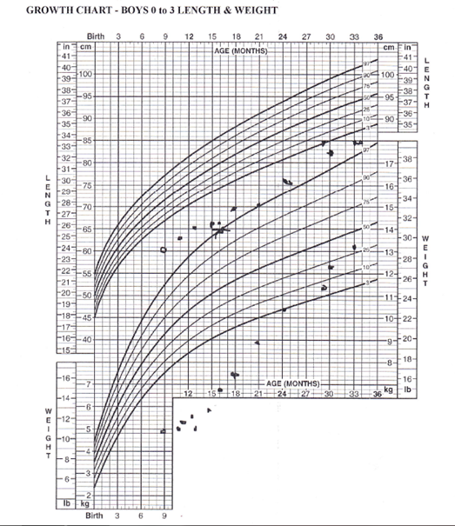
‘Michael’s Story’ –

Slide 6


Aberrant Behavior …
Aberrant behavior begins early in life
  System has to focus on behavior in preschool years
    Assessments
    Etiology
    Interventions
  Earlier you identify and address, the better the outcome
Case Study

Slide 7

A loving, nurturing, environment…
A loving, nurturing, and supportive environment that is both constant and intentional diffuses negative behaviors
  Needs to be pervasive
    School Climate
    Staff attitudes
    Home environment
  Case Study

